Slide 1
Google Data Analytics Capstone
Cyclistic Bike-Share Analysis
By: Ayush Adhikari

Slide 2
AGENDA
Analyzing how casual and member riders use Cyclitic bikes differently.
Recommending strategies to convert casual riders into annual members.
Data: https://divvytripdata.s3.amazonaws.com/index.html ( Taken data from 2023-2024 for study)

Slide 3
Prepare
Data Source:
Divvy public data (12 months of ride logs , chosen 23-24)
https://divvytripdata.s3.amazonaws.com/index.html
Cleaned to remove missing timestamps, negative ride lengths, and invalid rows.
- Columns used: ride_id, started_at, ended_at, member_casual, etc.

Slide 4

Process
Data Cleaning Performed :
Parsed timestamps using R lubridate
- Removed NA and malformed entries
Used syntax - ggplot2, dplyr: for visualizations and data manipulation
- Calculated ride length, day of week, and month

Slide 5
Analysis
Weaving through data – Resulting in:
Members take more frequent, shorter rides on weekdays.
Casual riders prefer weekends and longer ride durations
Peak usage for casuals: Saturday and Sunday
Members ride more consistently throughout the week

Slide 6
Visualization
Visual Representation of analysis.
- Ride counts by day of week (bar chart)
- Average ride length by user type (bar chart)
- Analytics of future forecasting if recommendation is implemented.
Exported visuals from R

Slide 7
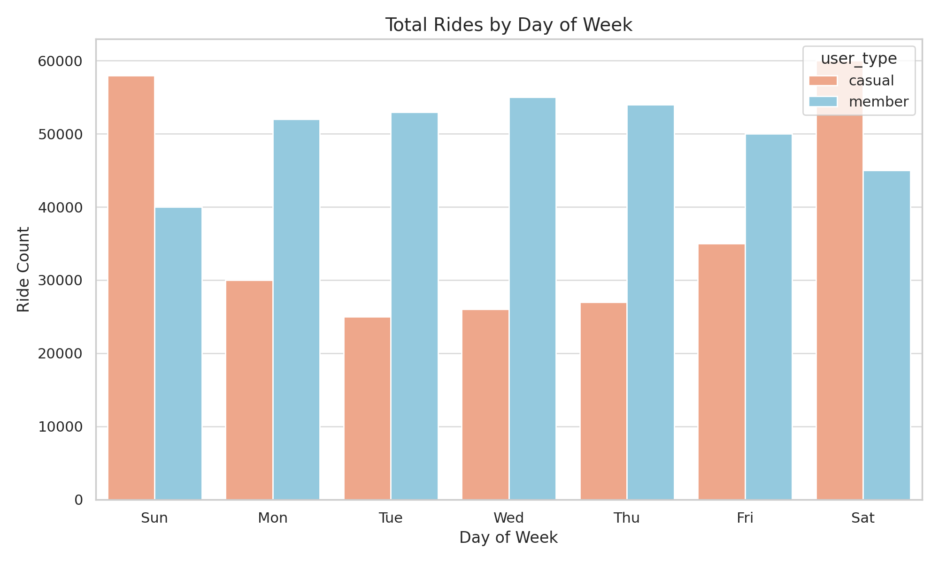
Total rides by day of week

Slide 8
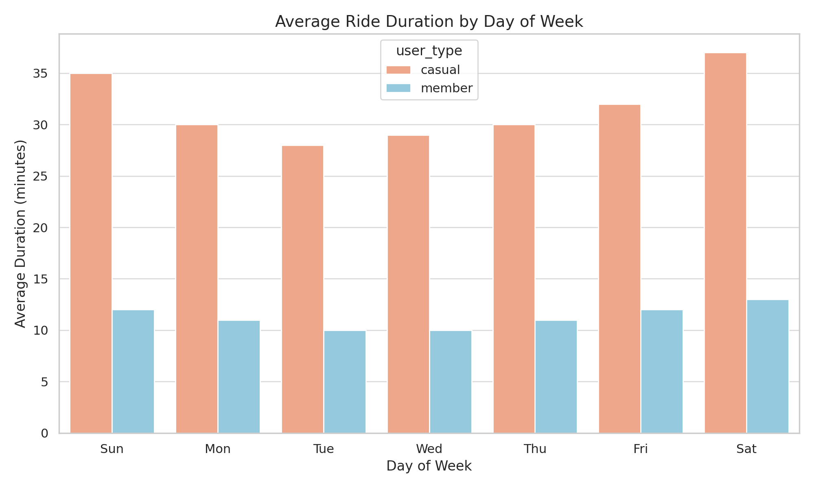
Average ride – duration/day of week

Slide 9
act
Recommendations:
Launch weekend promotions targeting casual riders
Highlight annual membership savings and convenience
Partner with tourist hotspots to promote conversion
Use in-app notifications during popular casual usage times

Slide 10
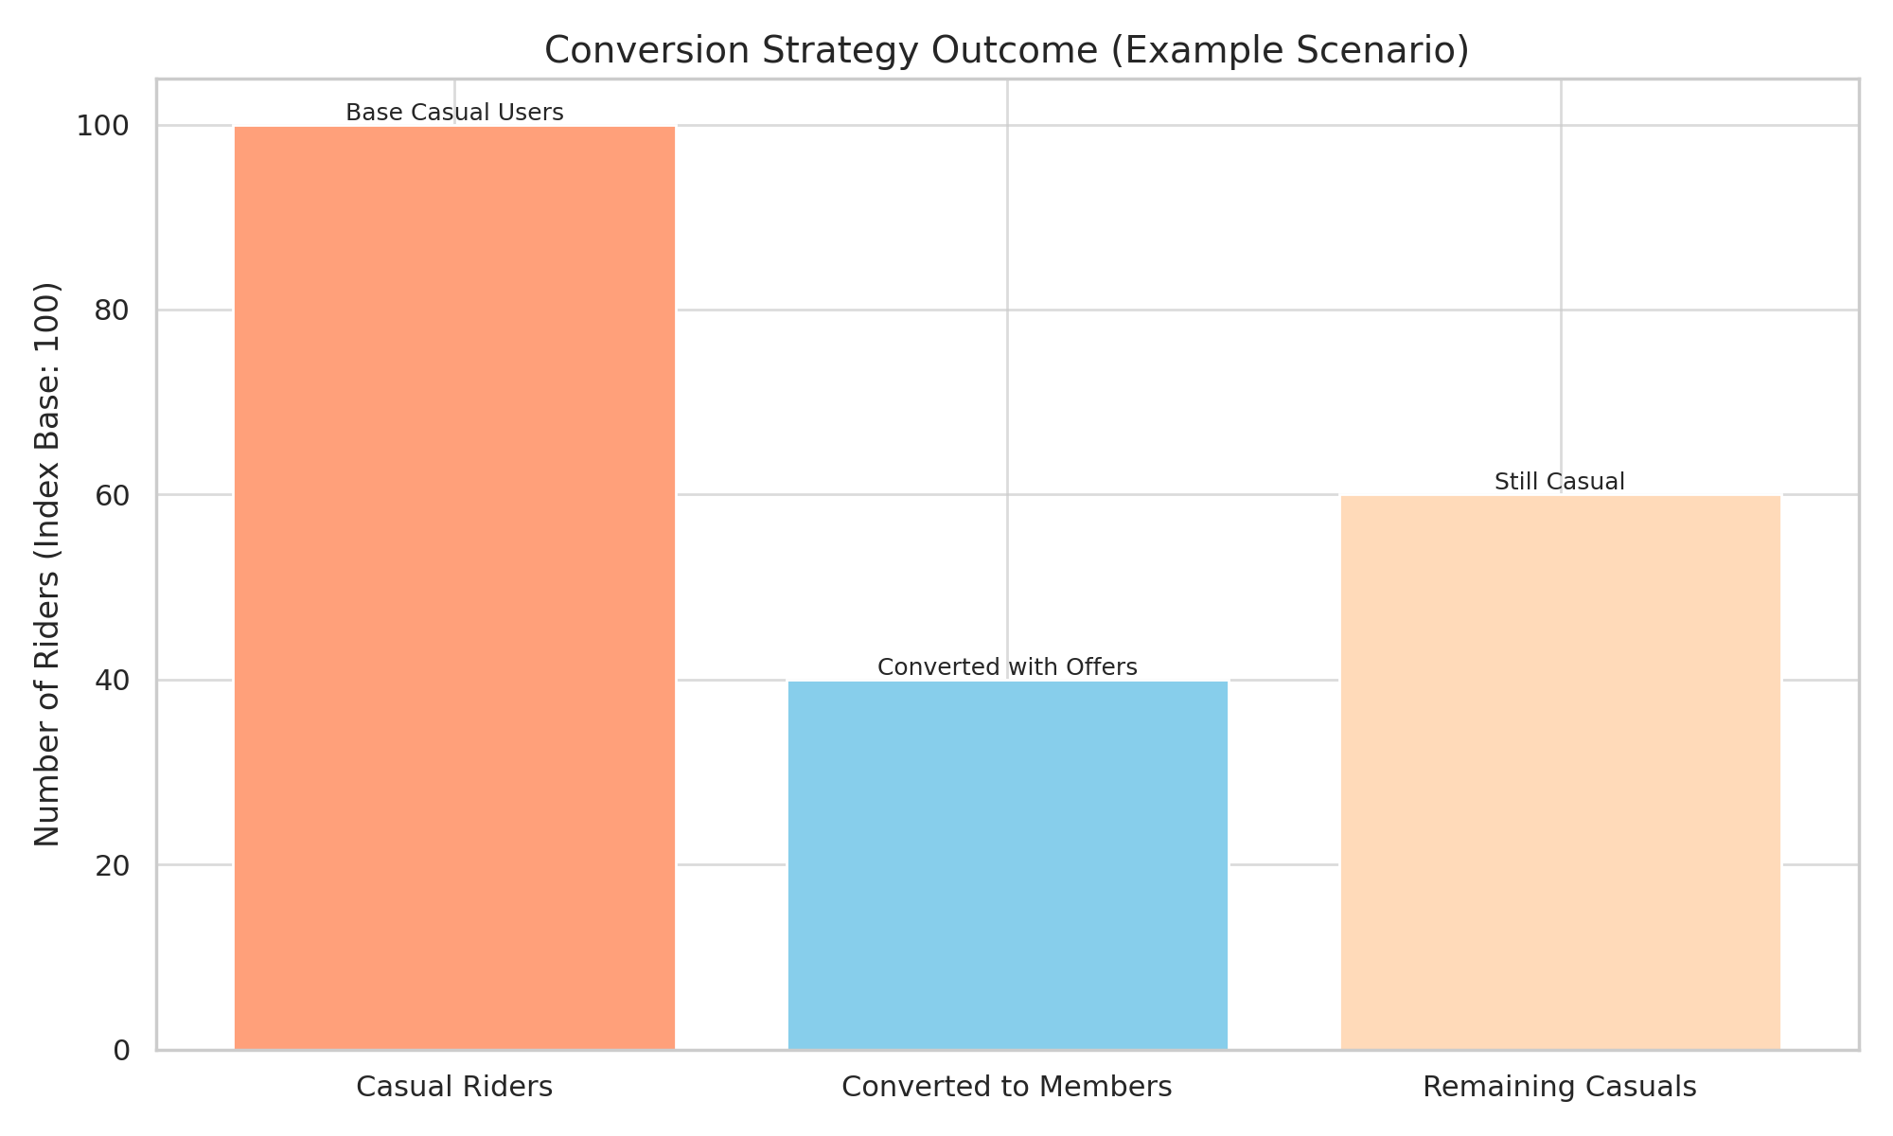
Conversion forecasting outcome:

Slide 11
THANK YOU
Ayush Adhikari
Emial : ayush.ad@live.com

